Slide 1
Chapter 6: Mining Frequent Patterns, Association and Correlations: Basic Concepts and Methods
Basic Concepts
Frequent Itemset Mining Methods
Which Patterns Are Interesting?—Pattern Evaluation Methods
Summary

Slide 2
Patterns and Itemsets (Intro)
Details later
A pattern/itemset is a set of items
  A pattern represents a condition on tuples
For transactional data (e.g. shopping baskets): an item is a product (type)
  Pattern example: {Diaper, Nut}, or Diaper & Nut
For relational data (e.g. health data): an item is a single-attribute condition
  Pattern example: Age > 25 & Height < 5.5
For sequence data: an item is a single-position condition
  Pattern example: Pos1=A & Pos3=G
Data Mining: Concepts and Techniques

Slide 3
Pattern Mining, Roughly Speaking
Mining a set of patterns for some goals/conditions
  Conditions/goals can have varying complexity
Mining is done by searching w.r.t. given dataset
The mined patterns are often used to solve other problems
Pattern mining is very computationally intensive
So one often works with simple goals/conditions
Even then we need clever techniques
Pattern mining is highly explorative – hard to link usefulness of patterns to goals
Data Mining: Concepts and Techniques

Slide 4
What Is Frequent Pattern Analysis?
Frequent pattern: a pattern that occurs frequently in a data set
  First proposed by Agrawal, Imielinski, and Swami [AIS93] in the context of frequent itemsets and association rule mining
Motivation: Finding inherent regularities in data
  What products were often purchased together?— Beer and diapers?!
  What are the subsequent purchases after buying a PC?
  What kinds of genes expressions are often associated with a cancer?
  What patterns are useful for automatically classifying web documents?
Applications
  Basket data analysis, cross-marketing, catalog design, sale campaign analysis, Web log (click stream) analysis, DNA sequence analysis, classification, clustering, outlier analysis, …

Slide 5
Why Is Freq. Pattern Mining Important?
Freq. patterns: intrinsic & important properties hidden in data
Foundation for many important data mining tasks
  Association, correlation, and causality analysis
  Sequential, structural (e.g., sub-graph) patterns
  Classification/regression: contrast pattern analysis
  Cluster analysis: frequent pattern-based clustering
  Data warehousing: iceberg cube and cube-gradient
  Semantic data compression
  Broad applications
GD used (contrast) patterns in classification, clustering, regression, prediction model analysis, intrusion detection, outlier detection, …

Slide 6
Basic Concepts: Frequent Patterns
itemset: A finite set of items
k-itemset X = {x₁, …, x_{k}}
(absolute) support, or, support count of X: Frequency or occurrence of an itemset X
(relative) support, s, is the fraction of transactions that contain X (= the probability that a transaction contains X)
An itemset X is frequent if X’s support is no less than a given minsup threshold
mds(X): X’s matching dataset is the set of rows matching X
  sup(X) = |mds(X)|
Tid | Items bought
t1 | Beer, Nuts, Diaper
t2 | Beer, Coffee, Diaper
t3 | Beer, Diaper, Eggs
t4 | Nuts, Eggs, Milk
t5 | Nuts, Coffee, Diaper, Eggs, Milk
Each row is a transaction
mds({Diaper})
t1,t2,t3,t5
Transactions that contain diaper
Match: aka satisfy

Slide 7
Basic Concepts: Association Rules
mds({Beer}) = {t1,t2,t3}
mds({Beer,Diaper}) = {t1,t2,t3}
mds({Diaper}) = {t1,t2,t3,t5}
Let minsup = 50%.
Freq. Pat. & Support (count):
Beer:3, Nuts:3, Diaper:4,
Eggs:3, {Beer, Diaper}:3
Freq. Pat. & Support (fraction):
Beer:0.6, Nuts:0.6, Diaper:0.8,
Eggs:0.6, {Beer, Diaper}:0.6
Sub-pattern, super-pattern: Y is super-pattern of X , and X is sub-pattern of Y, if Y כ X
Tid | Items bought
t1 | Beer, Nuts, Diaper
t2 | Beer, Coffee, Diaper
t3 | Beer, Diaper, Eggs
t4 | Nuts, Eggs, Milk
t5 | Nuts, Coffee, Diaper, Eggs, Milk
mds({Diaper})
t1,t2,t3,t5
Transactions containing diaper

Slide 8
Basic Concepts: Association Rules
Association rule: X → Y
  X and Y are itemsets
Two AR measures
  support, s: probability that a transaction contains X ∪ Y
  confidence, c: conditional probability that a transaction containing X also contains Y
Let minsup = 50%, minconf = 50%
Freq. Pat. & Support: Beer:3, Nuts:3, Diaper:4, Eggs:3, {Beer, Diaper}:3
Tid | Items bought
t1 | Beer, Nuts, Diaper
t2 | Beer, Coffee, Diaper
t3 | Beer, Diaper, Eggs
t4 | Nuts, Eggs, Milk
t5 | Nuts, Coffee, Diaper, Eggs, Milk
Customers who buy both
Customers who buy diaper
Association rules: (many more!)
  Beer → Diaper (60%, 100%)
  Diaper → Beer (60%, 75%)
Customers who
buy beer

Slide 9
Basic Concepts: Association Rules
Tid | Items bought
t1 | Beer, Nuts, Diaper
t2 | Beer, Coffee, Diaper
t3 | Beer, Diaper, Eggs
t4 | Nuts, Eggs, Milk
t5 | Nuts, Coffee, Diaper, Eggs, Milk
Association Mining Problem:
Find all the asso rules X → Y meeting given minsup and minconf thresholds
Frequent Pattern Mining Problem:
Find all frequent patterns meeting given minsup threshold
There is an algorithm to derive all association rules from all frequent patterns
Customer
buys both
Customer
buys diaper
Customer
buys beer

Slide 10
Closed Patterns, Equivalence Classes, Minimal Generators
A long pattern contains an exponential number of sub-patterns, e.g., {a₁, …, a₁₀₀} contains (₁₀₀¹) + (₁₀₀²) + … + (₁¹₀⁰₀⁰) = 2¹⁰⁰ – 1 = 1.27*10³⁰ sub-patterns!
  (₁₀₀^{k}) denotes number of k-combinations out of 100
A solution: Mine closed patterns
An itemset X is closed if there exists no proper super-pattern Y כ X such that sup(Y)=sup(X) (proposed by Pasquier, et al. @ ICDT’99)
  Closed patterns give a lossless compression of freq. patterns -- reducing the # of patterns
Closed patterns can also be defined in terms of mds
  An itemset X is closed if there exists no proper super-pattern Y כ X such that mds(Y)=mds(X)

Slide 11
Example: Frequent Closed Patterns
Closed Patterns
BD
EMN
CD
D
E
N
DE
Tid | Items bought
t1 | B, N, D
t2 | B, C, D
t3 | B, D, E
t4 | N, E, M
t5 | N, C, D, E, M
minsup=2
Frequent Patterns:
B:3,C:2,D:4,E:3,M:2,N:3
BD:3,CD:2,DE:2,EM:2,
EN:2,MN:2, EMN:2
B: beer; N: nuts; D: diaper, …
How to find frequent closed patterns,
if the frequent patterns are given?
Iterate: Select longest for each supp and
remove their subpatterns w/ identical sup
from the list of candidates
Data Mining: Concepts and Techniques

Slide 12
Closed Patterns, Equivalence Classes, Minimal Generators
Closed patterns give a lossless compression of freq. patterns -- reducing the # of (needed) patterns (representing all freq patts)
Closed patterns can also be used to examine the structure of the set of frequent patterns.
An equivalence class (EC) of patterns is a maximal set of patterns sharing the same mds.
  There is a 1-1 relationship between ECs, closed patterns, and mds:
    An EC is associated with one closed pattern, one mds
  An EC has several minimal generators: they are minimal patterns in the EC (they do not contain any proper sub-patterns that are also in the EC)
  The closed pattern and the MGs characterize the EC.
    Maximum vs minimal – under set containment
    Longest vs ???

Slide 13
Example of Closed Patterns, Minimal Generators, and Equivalence Classes
Closed Pattern | Minimal Generator | Support
BD | B | 3
EMN | M,EN | 2
CD | C | 2
D | D | 4
E | E | 3
N | N | 3
DE | DE | 2
Tid | Items bought
t1 | B, N, D
t2 | B, C, D
t3 | B, D, E
t4 | N, E, M
t5 | N, C, D, E, M
minsup=2
Frequent Patterns:
B:3,C:2,D:4,E:3,M:2,N:3
BD:3,CD:2,DE:2,EM:2,
EN:2,MN:2, EMN:2
EC(BD)={B,BD}
EC(EMN)={M,EM,EN,MN,EMN}
MinGen -- underlined
Go from long ones to short ones to determine ECs.
B: beer; N: nuts; D: diaper, …
Data Mining: Concepts and Techniques

Slide 14
Representing ECs
EC(EMN)={M,EM,EN,MN,EMN}
This EC can be represented by one of
  The closed: EMN
  One MG: M, or EN
Closed ➔ often contains lots of redundancy in it
MGs ➔ concise; but too many, need to choose;
Asso rules:
M→E (40%,100%)
M→ N (40%,100%)
EN→M (40%,100%)
Data Mining: Concepts and Techniques

Slide 15
Number of ECs, Sizes of ECs
Number of ECs – often billions
Sizes of an EC – can be thousands
Need to select some for use …
Data Mining: Concepts and Techniques

Slide 16
Pattern, Subpopulation, Opportunity
Given an application and goal
Collect a dataset D
Want to use patterns to do better
  Look at various patterns P
  Examine how data instances in mds(P) behave
    Similar to the behavior of all data?
    Different from that of most other data?
    Is P an exploitable opportunity?
  mds(P): subpopulation defined by P
Note: Different patterns can have highly overlapping mds
Behavior:
sometimes can
use a pred model
Data Mining: Concepts and Techniques

Slide 17
Computational Complexity of
Frequent Itemset Mining
How many itemsets can potentially be generated in the worst case?
  The number of frequent itemsets is sensitive to the minsup threshold
  When minsup is low, there exist potentially an exponential number of frequent itemsets
  The worst case: M^{N} where M: # distinct items, and N: max length of transactions [realizable?]
The worst case complexity vs. the expected probability [under uniform distr]
  Ex. Suppose Walmart has 10⁴ kinds of products
    The random chance to pick up one product: 10⁻⁴
    The random chance to pick up a particular set of 10 products: ~10⁻⁴⁰
    What is the expected frequency for a particular set of 10 products?
      Under expected probability, no pattern will be frequent, even for minsup= 10⁻²⁰
      But in real life, many 10-itemsets can be frequent for minsup=1%
    Expected: no regularity; everything behaves independently
Notes:
Expected frequency of a 10-itemset in 10^9 transactions -- 10^(-40) * 10^9 = 10^{-31)
In real life data, there should be frequent 10-itemsets with e.g. support >= 10%.

Slide 18
Chapter 6: Mining Frequent Patterns, Association and Correlations: Basic Concepts and Methods
Basic Concepts
Frequent Itemset Mining Methods
Which Patterns Are Interesting?—Pattern Evaluation Methods
Summary

Slide 19
Scalable Frequent Itemset Mining Methods
Apriori: A Candidate Generation-and-Test Approach
Improving the Efficiency of Apriori
FPGrowth: A Frequent Pattern-Growth Approach
ECLAT: Frequent Pattern Mining with Vertical Data Format
skip in 1st pass
skip in 1st pass

Slide 20
The Downward Closure Property and Scalable Mining Methods
The downward closure property of frequent patterns
  Any subset of a frequent itemset must also be frequent
    If {beer, diaper, nuts} is frequent, so is {beer, diaper}
    because every transaction containing {beer, diaper, nuts} also contains {beer, diaper}
  If X is infrequent, then all super-patterns of X are also infrequent.
Scalable mining methods: Three major approaches
  Apriori (Agrawal & Srikant@VLDB’94)
  Freq. pattern growth (FPgrowth—Han, Pei & Yin @SIGMOD’00)
  Vertical data format approach (Charm—Zaki & Hsiao @SDM’02)
Aka anti-monotonicity

Slide 21
Apriori: A Candidate Generation & Test Approach
Apriori pruning principle: If an itemset is infrequent, all its supersets don’t need to be generated/tested! (Agrawal & Srikant @VLDB’94, Mannila, et al. @ KDD’ 94)
Method:
  Initially, scan DB once to get frequent 1-itemsets
  Generate length (k+1) candidate itemsets from length k frequent itemsets
  Test the candidates against DB
  Terminate when no new frequent or candidate itemsets can be generated

Slide 22
The Apriori Algorithm—An Example
minSup = 2
Itemset | sup
{A} | 2
{B} | 3
{C} | 3
{D} | 1
{E} | 3
Database TDB
Itemset | sup
{A} | 2
{B} | 3
{C} | 3
{E} | 3
L₁
Tid | Items
10 | A, C, D
20 | B, C, E
30 | A, B, C, E
40 | B, E
C₁
1st scan
C₂
Itemset | sup
{A, B} | 1
{A, C} | 2
{A, E} | 1
{B, C} | 2
{B, E} | 3
{C, E} | 2
C₂
L₂
Itemset
{A, B}
{A, C}
{A, E}
{B, C}
{B, E}
{C, E}
Itemset | sup
{A, C} | 2
{B, C} | 2
{B, E} | 3
{C, E} | 2
2nd scan
C₃
Itemset
{B, C, E}
3rd scan
L₃
Itemset | sup
{B, C, E} | 2

Slide 23
The Apriori Algorithm (Pseudo-Code)
C_{k} : Candidate itemsets of size k
L_{k} : Frequent itemsets of size k
L₁ = {frequent items};
for (k = 1; L_{k} !=∅; k++) do begin
C_{k+1} = candidates generated from L_{k};
for each transaction t in database do begin
  increment the count of all candidates in C_{k+1} that are contained in t;
  end
L_{k+1} = candidates in C_{k+1} satisfying minSup;
end
return ∪_{k} L_{k};
Notation

Slide 24
Apriori’s Candidate Generation
Items in itemsets are in some sorted order;
join two itemsets if they have common (k-1)-prefix
How to generate candidates?
  Step 1: self-joining L_{k}
  Step 2: pruning
Example of candidate generation
  L₃={abc, abd, acd, ace, bcd}
  Self-joining: L₃*L₃
    abcd from abc and abd
    acde from acd and ace
  Pruning:
    acde is removed because ade is not in L₃
  Final C₄ = {abcd}
Join gives raw
C4={abcd, acde}
C1 = set of all items.

Slide 25
How to Count Supports of Candidates?
Counting supports of candidates is an issue
  The total number of candidates can be huge
  One transaction may contain many candidates
Method:
  Candidate itemsets are stored in a hash-tree
    Each leaf node contains a list of itemsets and counts
    Each interior node contains a table [mapping hash value to children nodes]
    Subset function: generates all the candidate k-itemsets contained in each given transaction
Why not a standard search tree?

Slide 26
Counting Supports of Candidates Using Hash Tree
hash function h: item → child
Recursively generate all k subsets of transaction at various nodes of the tree
h(i)=(i-1) mod 3
Transaction: 1 2 3 5 6
0
2
1
1 + 2 3 5 6
hash ith item of
itemsets at ith
level to decide
where to go
1 3 + 5 6
2 3 4
5 6 7
1 4 5
3 4 5
3 5 6
3 5 7
6 8 9
3 6 7
3 6 8
1 3 6
1 2 + 3 5 6
1 2 4
4 5 7
1 2 5
4 5 8
1 5 9
Do in class: build this hash tree given the 15 3-itemsets
head: items to the left of +
hash function divides items into groups
Tree also useful for
join + pruning
Notes:
Generating subsets of a transaction, for a node:
heads (how we got here), tail (items to process)

Slide 27
Inserting into Hash Tree
Insert 15 3-itemsets
into a hash tree
h(i)=(i-1) mod 3
???
???
True leaf nodes: level =3
Splittable nodes: level <3
2 3 4
5 6 7
1 2 5
4 5 8
A splittable node can contain <=3 itemsets
A true leaf node: unlimited # of itemsets
1 2 4
4 5 7
3 5 6
3 5 7
6 8 9
1 5 9
3 4 5
1 4 5
1 3 6
3 6 7
3 6 8
Notes:
Generating subsets of a transaction, for a node:
heads (how we got here), tail (items to process)

Slide 28
More on Hash Tree
Assumptions:
  An order on the items
  Hash function h
    This also tells us the number of children per node
  Capacity of splittable nodes [how many itemsets can be held at such a node]
Only need to consider joining itemsets if they are in the same splittable node or they are in non-splittable leaf nodes sharing a parent
2023 midterm:
Up to this slide
Data Mining: Concepts and Techniques

Slide 29
Candidate Generation: An SQL Implementation
SQL-like implementation of candidate generation
  Suppose the items in L_{k-1} are listed in an order
  Step 1: self-joining L_{k-1}
    insert into C_{k}
    select p.item₁, p.item₂, …, p.item_{k-1}, q.item_{k-1}
    from L_{k-1} p, L_{k-1} q
    where p.item₁=q.item₁, …, p.item_{k-2}=q.item_{k-2}, p.item_{k-1} < q.item_{k-1}
  Step 2: pruning
    forall itemsets c in C_{k} do
      if there exists (k-1)-subsets s of c such that (s is not in L_{k-1})
      then delete c from C_{k}
Use object-relational extensions like UDFs, BLOBs, and Table functions for efficient implementation [S. Sarawagi, S. Thomas, and R. Agrawal. Integrating association rule mining with relational database systems: Alternatives and implications. SIGMOD’98]

Slide 30
Scalable Frequent Itemset Mining Methods
Apriori: A Candidate Generation-and-Test Approach
Improving the Efficiency of Apriori
FPGrowth: A Frequent Pattern-Growth Approach
Mining Closed Frequent Patterns

Slide 31
Further Improvement of the Apriori Method
Major computational challenges
  Multiple scans of transaction database
  Huge number of candidates
  Tedious workload of support counting for candidates
Improving Apriori: general ideas
  Reduce passes of transaction database scans
  Shrink number of candidates
  Facilitate support counting of candidates
skip in 1st pass

Slide 32
Partition: Scan Database Only Twice
skip in 1st pass
Any itemset that is potentially frequent in DB must be frequent in at least one of the partitions of DB
  Scan 1: partition database and find local frequent patterns, which are used to
  Scan 2: consolidate/determine global frequent patterns
A. Savasere, E. Omiecinski and S. Navathe, VLDB’95
DB₁
+
DB₂
+
+
DB_{k}
= DB
sup₁(i) < σ|DB₁|
sup₂(i) < σ|DB₂|
sup_{k}(i) < σ|DB_{k}|
sup(i) < σ|DB|

Slide 33
DHP: Reduce the Number of Candidates
A k-itemset whose corresponding hashing bucket count is below the threshold cannot be frequent
  Candidates: a, b, c, d, e, …
  Hash entries
    {ab, ad, ae}
    {bd, be, de}
    …
  Frequent 1-itemset: a, b, d, e
  ab is not a candidate 2-itemset if the sum of count of {ab, ad, ae} is below support threshold
J. Park, M. Chen, and P. Yu. An effective hash-based algorithm for mining association rules. SIGMOD’95
count
itemsets
skip in 1st pass
35
{ab, ad, ae}
88
{bd, be, de}
...
...
Count trans:
abd
102
{yz, qs, wt}
Hash Table

Slide 34
Sampling for Frequent Patterns
Select a sample of original database, mine frequent patterns within sample using Apriori
Scan database once to verify frequent itemsets found in sample, only borders of closure of frequent patterns are checked
  Example: check abcd instead of ab, ac, …, etc.
Scan database again to find missed frequent patterns
H. Toivonen. Sampling large databases for association rules. In VLDB’96
skip in 1st pass

Slide 35
DIC: Reduce Number of Scans
skip in 1st pass
ABCD
Once both A and D are determined frequent, the counting of AD begins
Once all length-2 subsets of BCD are determined frequent, the counting of BCD begins
ABC
ABD
ACD
BCD
AB
AC
BC
AD
BD
CD
Transactions
1-itemsets
A
B
C
D
Apriori
2-itemsets
…
{}
Itemset lattice
1-itemsets
S. Brin R. Motwani, J. Ullman, and S. Tsur. Dynamic itemset counting and implication rules for market basket data. In SIGMOD’97
2-items
DIC
3-items

Slide 36
Scalable Frequent Itemset Mining Methods
Apriori: A Candidate Generation-and-Test Approach
Improving the Efficiency of Apriori
FPGrowth: A Frequent Pattern-Growth Approach
Mining Closed Frequent Patterns

Slide 37
Pattern-Growth Approach: Mining Frequent Patterns Without Candidate Generation
Bottleneck of the Apriori approach
  Breadth-first (i.e., level-wise) search (many passes over data)
  Candidate generation and test: Often generates a huge number of candidates & tests those candidates using expensive counting
The FPGrowth Approach (J. Han, J. Pei, and Y. Yin, SIGMOD’ 00)
  Depth-first search
  Avoid explicit candidate generation
  Uses simpler kind of counting (less expensive)
Philosophy: Grow long patterns by adding local frequent items to short patterns
  If “abc” is a frequent pattern: Get all transactions containing “abc”, i.e., project DB on abc: DB|abc
  If “d” is a local frequent item in DB|abc → abcd is a frequent pattern

Slide 38
Construct FP-tree from a Transaction Database
TID Transactions Reduced (ordered) trans
100 {f, a, c, d, g, i, m, p} {f, c, a, m, p}
200 {a, b, c, f, l, m, o} {f, c, a, b, m}
300 {b, f, h, j, o, w} {f, b}
400 {b, c, k, s, p} {c, b, p}
500 {a, f, c, e, l, p, m, n} {f, c, a, m, p}
min_support = 3
{}
Header Table
Item frequency head
f 4
c 4
a 3
b 3
m 3
p 3
Scan DB once, find frequent 1-itemsets (single item patterns)
Sort frequent items into frequency descending order ➔ F-list
Scan DB again, construct FP-tree
f:4
c:1
c:3
b:1
b:1
a:3
p:1
m:2
b:1
F-list = f-c-a-b-m-p
p:2
m:1

Slide 39
Insertion into FP-tree: the process (can’t draw links/edges here)
TID Transactions Reduced (ordered) trans
100 {f, a, c, d, g, i, m, p} {f, c, a, m, p}
200 {a, b, c, f, l, m, o} {f, c, a, b, m}
300 {b, f, h, j, o, w} {f, b}
400 {b, c, k, s, p} {c, b, p}
500 {a, f, c, e, l, p, m, n} {f, c, a, m, p}
min_support = 3
Header Table
Item frequency head
f 4
c 4
a 3
b 3
m 3
p 3
{}
f
a
p
b
m
c
F-list = f-c-a-b-m-p

Slide 40
Partition Patterns and Databases
Given F-list = f-c-a-b-m-p, the set of all frequent patterns can be partitioned into several subsets:
  Patterns containing p
  Patterns containing m but no p
  Patterns containing b but none of {m,p}
  Patterns containing a but none of {b,m,p}
  Patterns containing c but none of {a, b, m, p}
  Pattern f
This partition is complete & has no redundancy
The computation corresponds to a depth-first invocation tree; issues: stopping, combining results

Slide 41
Find Patterns Having x From x-conditional Database
Starting at the frequent item header table in the FP-tree for D
Traverse the FP-tree by following the links of frequent item x
Accumulate all of transformed prefix paths of item x to form x’s conditional pattern base (D|x)
{}
Conditional pattern bases
item cond. pattern base
c f:3
a fc:3
b fca:1, f:1, c:1
m fca:2, fcab:1
p fcam:2, cb:1
Header Table
Item frequency head
f 4
c 4
a 3
b 3
m 3
p 3
f:4
c:1
c:3
b:1
b:1
a:3
p:1
m:2
b:1
D|p – the last row
p:2
m:1

Slide 42
From Conditional Pattern-bases to Conditional FP-trees
For each pattern-base D|x
  Accumulate the count for each item in D|x
  Construct the FP-tree for the frequent items of D|x [with a new F-list for D|x]
D|m:
m-conditional pattern base:
  fca:2, fcab:1
{}
Header Table
Item frequency head
f 4
c 4
a 3
b 3
m 3
p 3
f:4
c:1
All frequent patterns related to m
m,
fm, cm, am,
fcm, fam, cam,
fcam
{}
c:3
b:1
b:1

f:3

a:3
p:1
m:2
b:1
c:3
p:2
m:1
a:3
m-conditional FP-tree

Slide 43
Recursion: Mining Each Conditional FP-tree
Invocation tree (of recursive calls) contains:
Root Node on D
Node on D|p
…
Node on D|m
…
…
{}
Header Table
Item frequency head
f 4
c 4
a 3
b 3
m 3
p 3
f:4
c:1
c:3
b:1
b:1
a:3
p:1
m:2
b:1
p:2
m:1
All calls use same minSup …

Slide 44
Terminating recursive calls
No need to continue
recursive calls when
FP-tree is a stick
{}
f:3
c:3
a:3
m-conditional FP-tree
Frequent patterns from D|m:
f:3,c:3,a:3,fc:3,fa:3,ca:3,fca:3
Data Mining: Concepts and Techniques

Slide 45
Combining Patterns:
Combining x & FPs from D|x
Frequent patterns containing m:
mf:3,mc:3,ma:3,mfc:3,mfa:3,mca:3,mfca:3
m:3 was also added (e.g. before the call on D|m)
Each call is w.r.t. a pattern x
Combine x with FPs of D|x when returning
Detailed process – next
{}
f:3
c:3
a:3
m-conditional FP-tree
Frequent patterns from D|m:
f:3,c:3,a:3,fc:3,fa:3,ca:3,fca:3
Data Mining: Concepts and Techniques

Slide 46
FP-Growth: Invocation Tree & Result Composition
Invocation Tree
Root Node on D
Node on D|p
Node on D|m
……
min_support = 3
D
TID Transactions Reduced trans
100 {f, a, c, d, g, i, m, p} {f, c, a, m, p}
200 {a, b, c, f, l, m, o} {f, c, a, b, m}
300 {b, f, h, j, o, w} {f, b}
400 {b, c, k, s, p} {c, b, p}
500 {a, f, c, e, l, p, m, n} {f, c, a, m, p}
Work at root; producing 6 freq itemsets listed in header table
{}
Leftmost child of root (invocation tree): c:3 is
only freq itemset mined from this node.
{c:3} is combined with p:3 to give pc:3 as
new freq itemset (caller is the root)
Second leftmost child of root: f:3. c:3, a:3,
fc:3, fa:3, ca:3, fca:3 are the freq itemsets found
at this node. Combining them with m:3 gives
fm:3, cm:3, am:3, fcm:3, fam:3, cam:3, fcam:3
See the next slide
At each node: combine cond pattern with all freq itemsets
Mined from children node to yield new freq itemsets
Header Table
Item frequency head
f 4
c 4
a 3
b 3
m 3
p 3
f:4
c:1
c:3
b:1
b:1
a:3
p:1
m:2
b:1
p:2
m:1

Slide 47
Invocation Tree
Root Node on D
Node on D|p
Node on D|m
……
Combining patterns
in “recursive invocations”
min_support = 3
F-list for D
f:4, c:4, a:3, b:3, m:3, p:3
D|p: fcam:2, cb:1
F-list: c:3
Computed Frequent Patterns for D
f:4, c:4, a:3, b:3, m:3, p:3
D|m: fca:2, fcab:1
F-list: f:3,c:3,a:3
pc:3
fm:3, cm:3, am:3, fcm:3, fam:3, cam:3, fcam:3
D|b: fca:1, f:1, c:1
F-list: {}
???
D|a: fc:3
F-list: f:3,c:3
???
D|c: f:3
F-list: f:3
D|f: {}
???
???
We do similarly at any node with children

Slide 48
Benefits of the FP-tree Structure
Completeness
  Preserve complete information for frequent pattern mining
  Does not break long patterns in transactions
Compactness
  Reduce irrelevant info—infrequent items are gone
  Items in frequency descending order: the more frequently occurring, the more likely to be shared in paths of the tree
  Never be larger than the original database (not counting node-links and the count fields)

Slide 49
The Frequent Pattern Growth Mining Method
Idea: Frequent pattern growth
  Recursively grow frequent patterns by pattern and database partition
Method
  For each frequent item, construct its conditional pattern-base, and then its conditional FP-tree
  Repeat the process on each newly created conditional FP-tree
  Until the resulting FP-tree is empty, or it contains only one path (a stick) — this path will generate all the combinations of its sub-paths, each of which is a frequent pattern

Slide 50

FP-Growth vs. Apriori: Scalability With the Support Threshold
Data set T25I20D10K
IBM Synth. Dataset:
Average Trans length: 25
Itemset length: 20
#Transactions: 10K

Slide 51
Advantages of the Pattern Growth Approach
Divide-and-conquer:
  Decompose both the mining task and DB according to the frequent patterns obtained so far
  Lead to focused search over smaller databases
Other factors
  No candidate generation, no candidate test, no subset checks
  Compressed database: FP-tree structure
  No repeated scans of the entire database
  Basic ops: counting local frequent items and building sub FP-tree, no pattern search and matching
A good open-source implementation and refinement of FPGrowth
  FPGrowth+ (Grahne and J. Zhu, FIMI'03)
  Also https://github.com/chen0040/java-frequent-pattern-mining

Slide 52
Extension of Pattern Growth Mining Methodology
Mining closed frequent itemsets and max-patterns
  CLOSET (DMKD’00), FPclose, and FPMax (Grahne & Zhu, Fimi’03)
Mining sequential patterns
  PrefixSpan (ICDE’01), CloSpan (SDM’03), BIDE (ICDE’04)
Mining graph patterns
  gSpan (ICDM’02), CloseGraph (KDD’03)
Constraint-based mining of frequent patterns
  Convertible constraints (ICDE’01), gPrune (PAKDD’03)
Computing iceberg data cubes with complex measures
  H-tree, H-cubing, and Star-cubing (SIGMOD’01, VLDB’03)
Pattern-growth-based Clustering
  MaPle (Pei, et al., ICDM’03)
Pattern-Growth-Based Classification
  Mining frequent and discriminative patterns (Cheng, et al, ICDE’07)

Slide 53
Scalable Frequent Itemset Mining Methods
Apriori: A Candidate Generation-and-Test Approach
Improving the Efficiency of Apriori
FPGrowth: A Frequent Pattern-Growth Approach
Mining Closed Frequent Patterns

Slide 54
Mining Frequent Closed Patterns: CLOSET info
Flist: list of all frequent items in support ascending order
  Flist: d-a-f-e-c
Divide search space
  Patterns having d
  Patterns having d but no a, etc.
Find frequent closed pattern recursively
  Every transaction having d also has cfa → cfad is a frequent closed pattern
J. Pei, J. Han & R. Mao. “CLOSET: An Efficient Algorithm for Mining Frequent Closed Itemsets", DMKD'00.
Min_sup=2
TID | Items
10 | a, c, d, e, f
20 | a, b, e
30 | c, e, f
40 | a, c, d, f
50 | c, e, f

Slide 55
CLOSET+: Mining Closed Itemsets by Pattern-Growth info
Itemset merging: if Y appears in every occurrence of X, then Y is merged with X
Sub-itemset pruning: if Y כ X and sup(X) = sup(Y), X and all of X’s descendants in the set enumeration tree can be pruned
Hybrid tree projection
  Bottom-up physical tree-projection
  Top-down pseudo tree-projection
Item skipping: if a local frequent item has the same support in several header tables at different levels, one can prune it from the header table at higher levels
Efficient subset checking
c

Slide 56
CHARM: Mining by Exploring Vertical Data Format [info]
Vertical format: t(AB) = {T₁₁, T₂₅, …}
  tid-list: list of trans.-ids containing an itemset (also bitset)
Deriving closed patterns based on vertical intersections
  t(X) = t(Y): X and Y always happen together
  t(X) ⊂ t(Y): transaction having X always has Y
Using diffset to accelerate mining
  Only keep track of differences of tids
  t(X) = {T₁, T₂, T₃}, t(XY) = {T₁, T₃}
  Diffset (XY, X) = {T₂}
Eclat/MaxEclat (Zaki et al. @KDD’97), VIPER(P. Shenoy et al.@SIGMOD’00), CHARM (Zaki & Hsiao@SDM’02)

Slide 57
Vertical Data Representation -- BitSet
TID | Items
10 | a, c, d, e, f
20 | a, b, e
30 | c, e, f
40 | a, c, d, f
50 | c, e, f
a | b | c | d | e | f
The horizontal format
The vertical BitSet format
Data Mining: Concepts and Techniques

Slide 58

Visualization of Association Rules: Plane Graph

Slide 59

Visualization of Association Rules: Rule Graph

Slide 60

Visualization of Association Rules
(SGI/MineSet 3.0)

Slide 61
Chapter 6: Mining Frequent Patterns, Association and Correlations: Basic Concepts and Methods
Basic Concepts
Frequent Itemset Mining Methods
Which Patterns Are Interesting?—Pattern Evaluation Methods
Summary

Slide 62



Interestingness Measure: Correlations (Lift)
play basketball ⇒ eat cereal [40%, 66.7%] is misleading
  The overall % of students eating cereal is 75% > 66.7%.
play basketball ⇒ not eat cereal [20%, 33.3%] is more informative, although with lower support and confidence
A measure of dependent/correlated events: lift
{} ⇒ eat cereal [75%, 75%]
Under
confident
 | Basketball | Not basketball | Sum (row)
Cereal | 2000 | 1750 | 3750
Not cereal | 1000 | 250 | 1250
Sum(col.) | 3000 | 2000 | 5000
Lift>1: if A and B are together
more often than expected
P(A)*P(B): expected
If P(AB) > P(A)*P(B)

Slide 63

Many Other Interestingness Measures of Correlation
“Buy walnuts ⇒ buy milk [1%, 80%]” is misleading if 85% of customers buy milk
Support and confidence are not good to indicate correlations
Over 20 interestingness measures have been proposed (see Tan, Kumar, Sritastava @KDD’02)
Which are good ones?
X
X
All_conf =
Min_conf
X
X
X
X

Slide 64
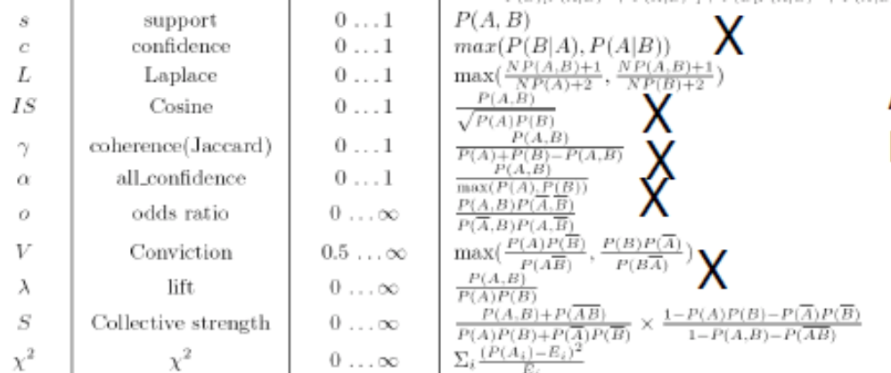
Many Other Interestingness Measures
of Correlation – Confidence, Cosine, Coherence, All-Confidence, Lift, X2
X
 | Basketball | Not basketball | Sum (row)
Cereal | 2000 | 1750 | 3750
Not cereal | 1000 | 250 | 1250
Sum(col.) | 3000 | 2000 | 5000
Data Mining: Concepts and Techniques

Slide 65
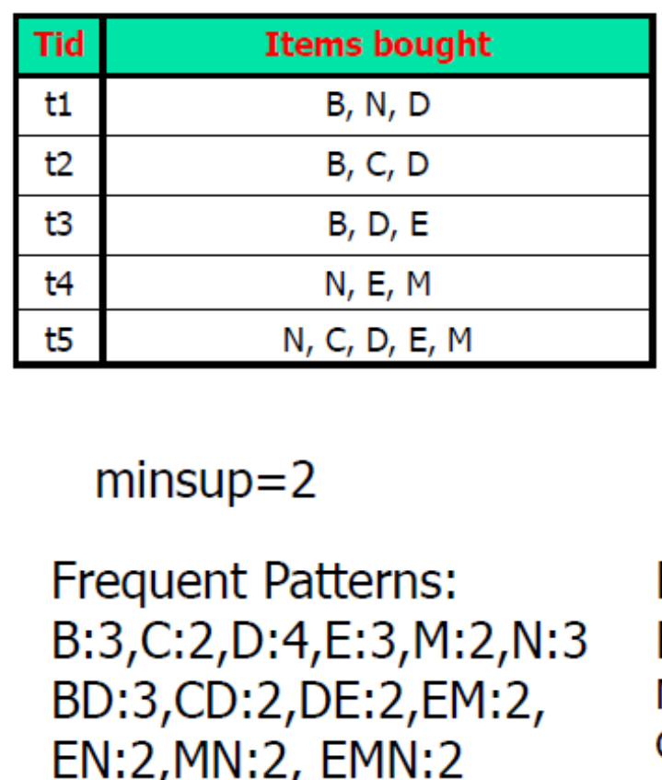
Contingency table from frequent patterns
Do not need to see the data (X) but need |X|
Table for d and e:
de:2
d~e:2
~de:1
~d~e:0
How? de : sup(de)
Do d~e and ~de: de+d~e=sup(d)
de+~de=sup(e)
Do ~d~e now: |X|-sum(other three entries)
Table for b and d:
bd:3
b~d:0
~bd:1
~b~d:1
X
 | e | ~e
d
~d
 | d | ~d
b
~b
Data Mining: Concepts and Techniques

Slide 66

Null-Invariant Measures
A measure is null-invariant, if the number of “null” transactions does not matter
P2: monotonically inc
P3: monotonically dec
Null: see
next slide
Explain P’s
via Tan paper

Slide 67


Comparison of Interestingness Measures
A measure is null-invariant, if the number of “null”
transactions (the red cell) does not affect the measure value.
Hint:
D1 D2 rows
allConf:
minConf
Null-(transaction) invariance is crucial for correlation analysis
Lift and χ² are not null-invariant
5 null-invariant measures
 | Milk | No Milk | Sum (row)
Coffee | m, c | ~m, c | c
No Coffee | m, ~c | ~m, ~c | ~c
Sum(col.) | m | ~m | Σ
Null-transactions w.r.t. m and c
Kulczynski measure (1927)
Null-invariant
Data Mining: Concepts and Techniques
Subtle: They disagree

Slide 68

Coauthor Relationship (DBLP):
When Are Some Measures High?
Recent DB conferences, removing balanced associations, low sup, etc.
Circled: Students who seldomly publish
after PhD vs
Others: Students who publish
independently after PhD
Advisor-advisee relation: Kulc: high, coherence: low, cosine: varies
High-low (degree): relatively, per measure
Tianyi Wu, Yuguo Chen and Jiawei Han, “Association Mining in Large Databases: A Re-Examination of Its Measures”, Proc. 2007 Int. Conf. Principles and Practice of Knowledge Discovery in Databases (PKDD'07), Sept. 2007

Slide 69


Which Null-Invariant Measure Is Better?
IR (Imbalance Ratio): measure the imbalance of two itemsets A and B in rule implications
Kulczynski and Imbalance Ratio (IR) together present a clear picture for all the three datasets D₄ through D₆
  D₄ is balanced & neutral
  D₅ is imbalanced & neutral
  D₆ is very imbalanced & neutral
Sup in D5:
c:1100
m:11000
Sup vs Contingency table
Kulc close to 0.5→ neutral
IR close to 0 → balanced

Slide 70
More on Interestingness of Patterns
A book was published on this topic:
  Knowledge Discovery and Measures of Interestingness
Patterns can be interesting when linked to something important (➔contrast patterns, emerging patterns, high-utility patterns);
  Useful for many tasks
Prediction,
Error Reduction,
Model Improvement
Opportunity Discovery
Data Mining: Concepts and Techniques

Slide 71
Defining Emerging Patterns
[Dong and Li 1999]
Given two datasets D1 and D2, the growthRate of a pattern P from D1 to D2 is:
  growthRate(P) = 0 if sup(P,D1)=sup(P,D2)=0
  growthRate(P) = infinity if sup(P,D1)=0 & sup(P,D2)>0
  growthRate(P) = sup(P,D2)/sup(P,D1) otherwise
(*) Given a growthRate threshold rho, P is an emerging pattern of D2 if growthRate(P)>=rho
  D2 is called P’s home group
P is a jumping emerging pattern if sup(P,D1)=0 & sup(P,D2)>0
Infinity: can be represented by a number >= |D2|+1.

Slide 72
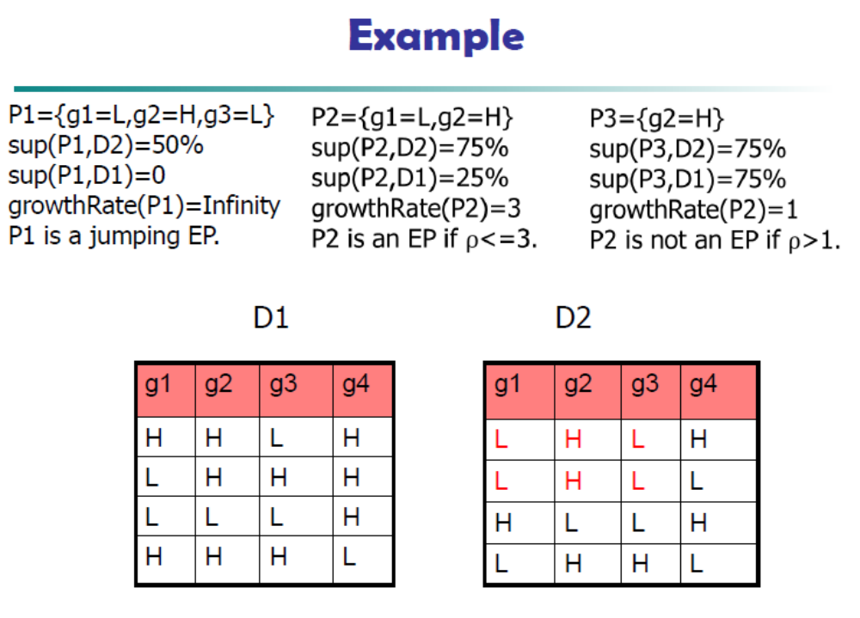

rho
Data Mining: Concepts and Techniques

Slide 73
Emerging/Contrast Patterns
D1 and D2: User defined; can be classes
A jumping emerging pattern X is an emerging pattern that occurs in one dataset but not in the other dataset; it is a minimal JEP if no proper subset of X is also a JEP.
Many uses of JEPs were proposed …
Data Mining: Concepts and Techniques

Slide 74
JEPs with high support for colon cancer
Colon Cancer EPs
{1+ 4- 112+ 113+} 100%
{1+ 4- 113+ 116+} 100%
{1+ 4- 113+ 221+} 100%
{1+ 4- 113+ 696+} 100%
{1+ 108- 112+ 113+} 100%
{1+ 108- 113+ 116+} 100%
{4- 108- 112+ 113+} 100%
{4- 109+ 113+ 700+} 100%
{4- 110+ 112+ 113+} 100%
{4- 112+ 113+ 700+} 100%
{4- 113+ 117+ 700+} 100%
{1+ 6+ 8- 700+} 97.5%
Colon Normal EPs
{12- 21- 35+ 40+ 137+ 254+} 100%
{12- 35+ 40+ 71- 137+ 254+} 100%
{20- 21- 35+ 137+ 254+} 100%
{20- 35+ 71- 137+ 254+} 100%
{5- 35+ 137+ 177+} 95.5%
{5- 35+ 137+ 254+} 95.5%
{5- 35+ 137+ 419-} 95.5%
{5- 137+ 177+ 309+} 95.5%
{5- 137+ 254+ 309+} 95.5%
{7- 21- 33+ 35+ 69+} 95.5%
{7- 21- 33+ 69+ 309+} 95.5%
{7- 21- 33+ 69+ 1261+} 95.5%
These EPs have 95%--100% support in one class but 0% support in the other class.
Minimal: Each proper subset occurs in both classes.
EPs from Mao+Dong 05 (gene club + border-diff).
4+: gene 4 > split of gene 4
4-: gene 4 <= split of gene 4
Colon cancer dataset (Alon et al, 1999 (PNAS)): 40 cancer tissues, 22 normal tissues. 2000 genes
Domain scientists call such patterns
Signature Patterns

Slide 75
Mining JEPs using Border-Diff
Given t=1234 and N={3456,2479,2358}
Find all minimal JEPs of t vs N
  minimal patterns occurring in t but not in N
Resulting minimal JEPs:1,234
All JEPs: 1,12,13,14,123,124,134,234,1234
Mining algorithm needs to perform repeated “minimization” operation efficiently
Itemized
data
Another way to mine EPs: Get frequent patterns of each Di
and then compare their supports in the two datasets.
Data Mining G Dong

Slide 76
Mining JEPs using Border-Diff
A set X is a JEP
if it contains one
item from each diff
How? t=1234, N={3456,2479,2358}
The algorithm computes differences between t and each individual transaction s in N, and then performs iterative expansion & minimization
The diffs: 1234-3456=12; 1234-2479=13; 1234-2358=14
Iterative expansion and minimization:
  a. {1,2} -- initialization
  b. {1,2} cross with {1,3} => {11,12,13,23}
  minimize => {1,23}
  c. {1,23} cross with {1,4} => {11,123,14,234}
  minimize => {1,234}
  Result minimal JEPs:1,234
In computing, the most expensive part is the minimization part!
Want minimal JEPs
Need efficiency
Change data
and play
Class: do same for t=2345, N={3456,2479,2358}
Data Mining G Dong

Slide 77
Summary
Basic concepts: association rules, support-confident framework, closed and max-patterns
Scalable frequent pattern mining methods
  Apriori (Candidate generation & test)
  Projection-based (FPgrowth, CLOSET+, ...)
  Vertical format approach (ECLAT, CHARM, ...)
Which patterns are interesting?
  Pattern evaluation methods
  Emerging/contrast patterns

